Slide 1
Sumi Dhakal
Overview of Magist Software Company

Slide 2
Magist
Background we know;
Magist is a Brazilian Software Service company - offers a centralized order management system to connect small and medium-sized stores with the biggest Brazilian marketplaces.
Magist is a big player and allows small companies to benefit from its economies of scale.
Things to explore;
Is Magist a good fit for high-end tech products?
Are orders delivered on time?

Slide 3
Parameters Explored
Based on the two main questions - these are the main parameters explored;
User growth of Magist over a time period.
Number of high tech products sold over a time period.
Reviews based on these products sold.
Products being delivered on time.
I looked at these factors,
User growth, high tech products sold, reviews, products being delivered,
How many sellers are there? How many Tech sellers are there? What percentage of overall sellers are Tech sellers?
What is the total amount earned by all sellers? What is the total amount earned by all Tech sellers?

Slide 4
How many orders are there in the dataset?
99441 %=??
How many products are there on the products table?
32951 %=??
How many Tech products are sold?
Products Number of Orders Percentage of Total Orders
computers 181 0.1820
computers_accessories 6689 6.7266
electronics 2550 2.5643
tablets_printing_image 79 0.0794

Slide 5
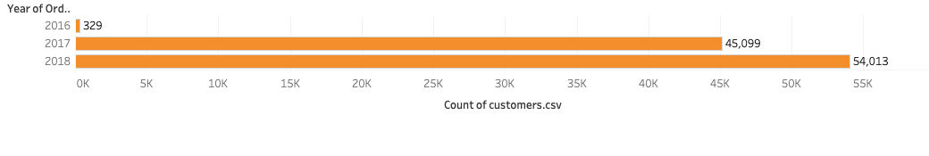
Data Visualization of User Growth

Slide 6
2. Are orders actually delivered?
High Tech Delivered Items =
order_status
orders
Delivered 96478
Unavailable 609
Shipped 1107
Canceled 625
Invoiced 314
Processing 301
Approved 2
Created 5

Slide 7
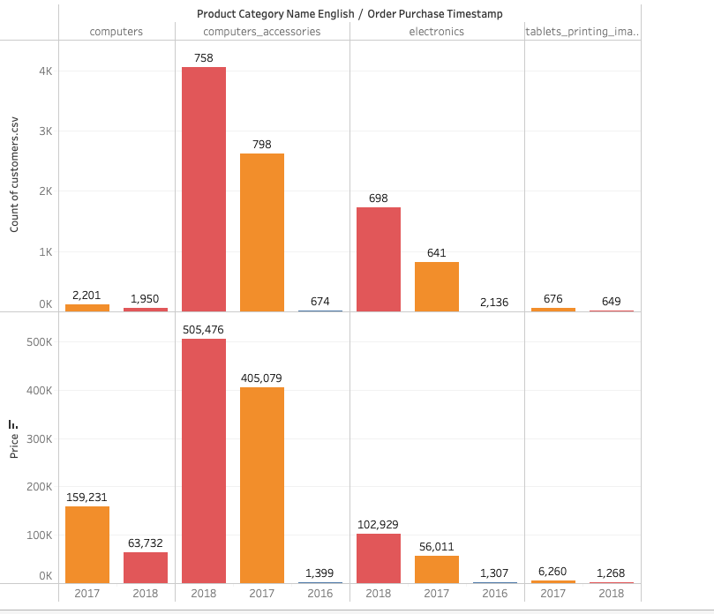
Data Visualization on Customers, Products and Price

Slide 8
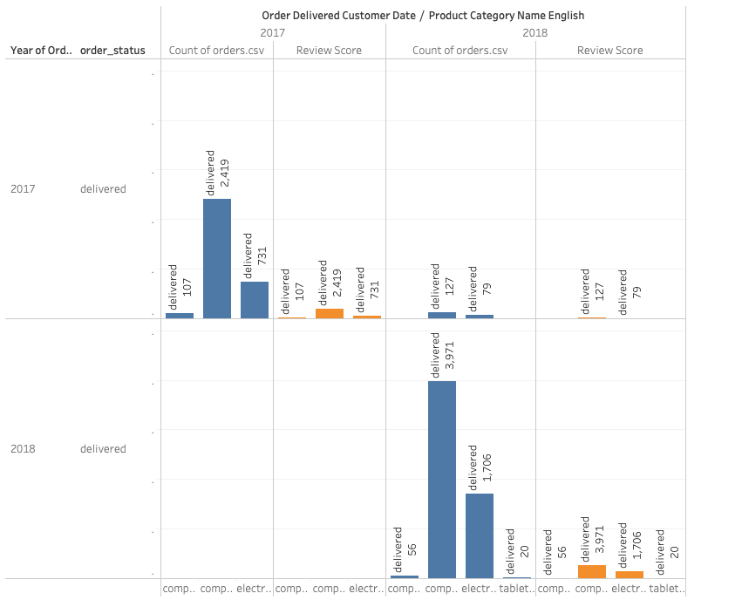
Data Visualization on Product, Orders, Review Score and Order Status

Slide 9
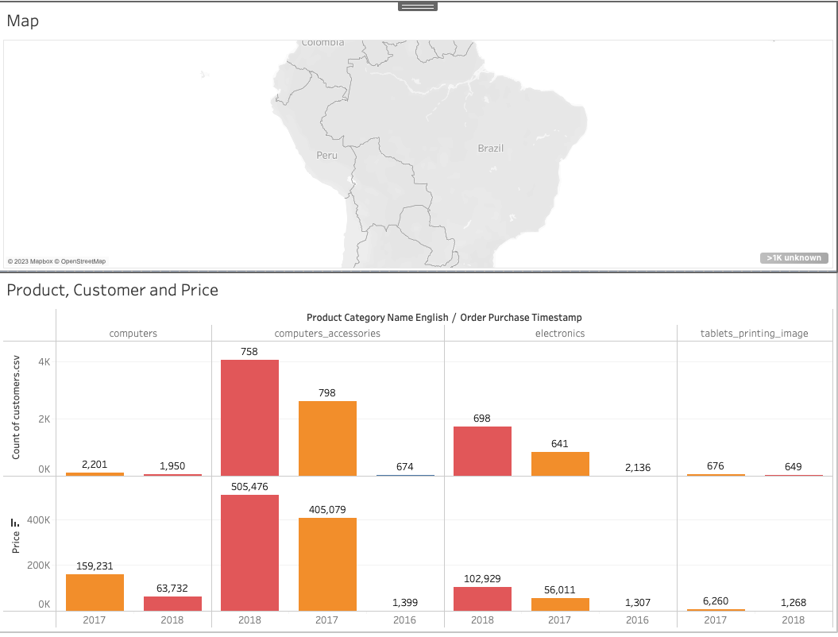
Dashboard

Slide 10
Conclusion
I don’t think so - Magist will be a good option at the moment to sign the contract with;
Looking at the user growth - increasing gradually only for non tech items whereas we are more focused on high tech products.
Number of high tech products are declining over time.
There is only few order reviews on high tech products - we can’t surely say if we can rely on these reviews based on non tech products.
Although wide range of products but limited number of high tech products.
Items are delivered on time but we can’t say the same for high tech products.
Therefore, it is best not to sign a contract now - since, we are looking for some high tech software company. But, Magist doesn’t fulfil our criteria. We can always work with them for non tech products.
Notes:
Revenue: 40,044,542 €
Avg monthly revenue: 1,011,256 €
Avg order price: 710 €
Avg item price: 540 €

